Slide 1

Instance Segmentation
Thierry Pécot
Research Associate
Translational Science Lab
Chan Zuckerberg Initiative Imaging Scientist

Slide 2
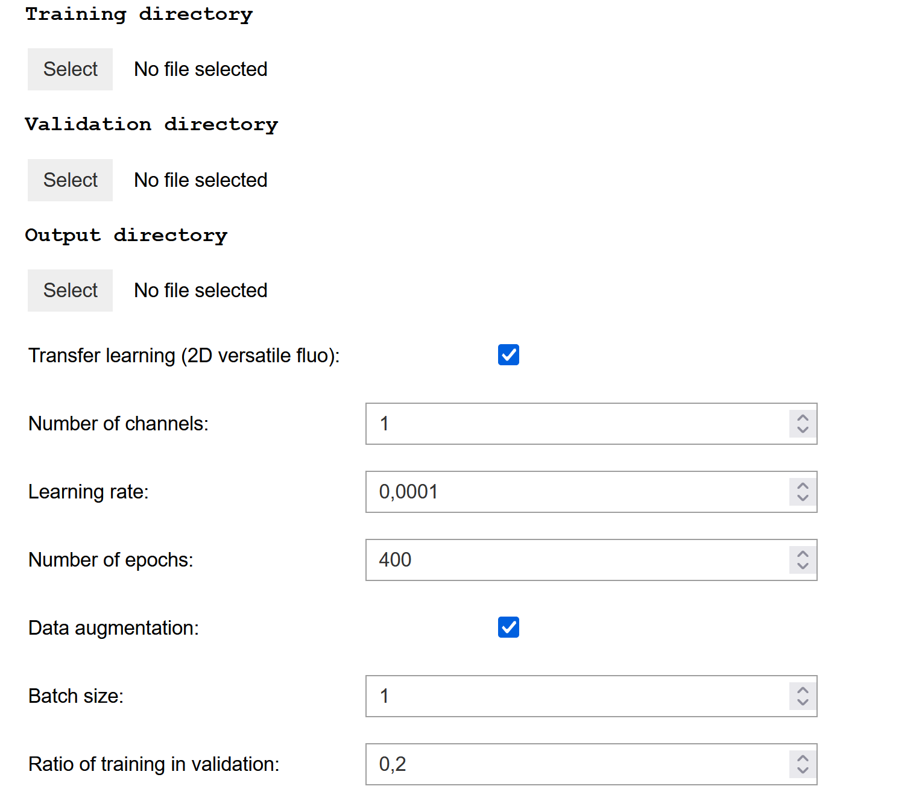
Training
Location of training dataset
If no validation directory is indicated, train_to_val_ratio of training dataset is randomly selected to define a validation dataset
Location of validation dataset
Location of trained model
Transfer learning from 2D versatile fluo model
Number of channels
Learning rate
Number of epochs
Data augmentation used for each image
Number of images trained at once

Slide 3
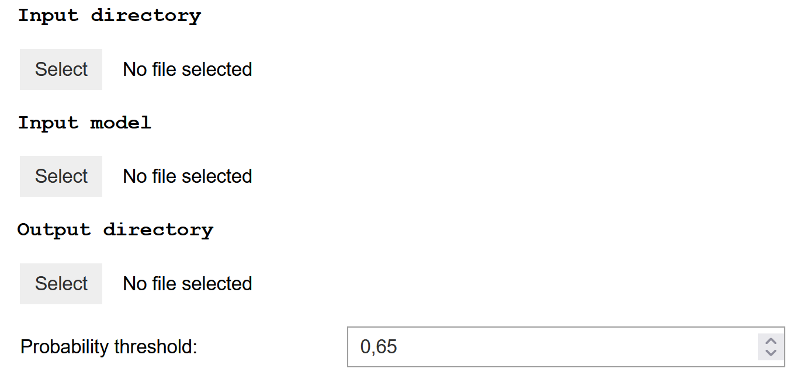
Running
Location of images to be processed
Location of trained classifier
Location for processed images
Threshold applied to probability for nuclei existence

